Slide 1




Discharge HUB
A DIVISION OF SEAFAIR

Slide 2




At Branch Innovations, we believe it is possible to create solutions that deliver better health, better business and better impact for our communities.
We do this as a Division of Seafair, building upon the notion of Unlocking Potential.
With roots in Newfoundland and Labrador, we are proud to work in close collaboration with NL Health Services as Innovation Partners.
Ayon Shahed
President, Branch Innovations
Vice President, Innovation & Business Development, Seafair ayon.shahed@seafaircapital.com
Melissa Berkshire
Director, Digital Healthcare Solutions Branch Innovations, a Division of Seafair melissa.berkshire@branchinnovations.ca

Slide 3





OwnCare

Slide 4
Agenda
The Challenge
DischargeHUB Overview
Impact & Learnings
Next Steps
Open Discussion

Slide 5
The Challenge
According to the Health Accord (2020), ~22% of hospital beds in Newfoundland and Labrador are filled by Alternate Level of Care (ALC) patients
Prolonged time as an ALC is resulting in poor patient and system outcomes
Patient Harm & Declining Health
Elevated Costs & Reduced Efficiency
Social isolation
Decline in overall condition
Exposure risk to other infections &
diseases
Undue stress for family members & caregivers
Mismatched allocation of care resources
Reduced productivity of clinical team
Diminished availability of beds for acute care
Negative public perception of healthcare system

Slide 6
Co-Developing a Solution with NLHS
Reverse Pitch in Fall 2021
Led to Limited Call RFP in Summer of 2022 for Collaborative Development and Pilot Solution
Partnered with Mobia Health
Won the RFP in Spring 2023
Co-Design & Development of Prototype in Summer & Fall 2023
Pilot launched January 2024
Engagement, Insights and
Collaboration
Clinical Efficiency
DPLNs & SWs & SWAs
OTs & PTs
Community Support Program
Digital Health Services
Innovation
Patient and Family Advocate
Workflow mapping
Process optimization
Interface design and testing
User acceptance testing
Privacy, security and architecture

Slide 7

DischargeHUB
A Managed Service solution, inclusive
of Software-as-a-Service, that centralizes and streamlines coordination of services & equipment required for patients to be discharged
from the acute care setting.
A DIVISION OF SEAFAIR CAPITAL

Slide 8
Current State & Expansion Opportunities
Patient Sources & Discharge Coordination | Discharge Destinations
Current State of NL Implementation: Patients in Acute Care Health Sciences Centre & St. Clare’s Mercy Hospital onboarded Jan 2024 Sir Thomas Roddick Hospital & Western Memorial Regional Hospital onboarded Nov 2024 Current Scope of Discharge Coordination Services: Home Support (agency only) Home Oxygen (private pay only) Home Equipment (private pay and Red Cross) | Current State of NL Implementation: Home discharges
Future Expansion Potential: Additional entry points: emergency departments, community-based, etc. Additional services coordination: rehabilitation, diabetic education, etc. Additional sites in NL and health jurisdictions in Canada … and more | Expansion Potential: Transitional Care Facilities Personal Care Homes Palliative Care Programs … and more

Slide 9
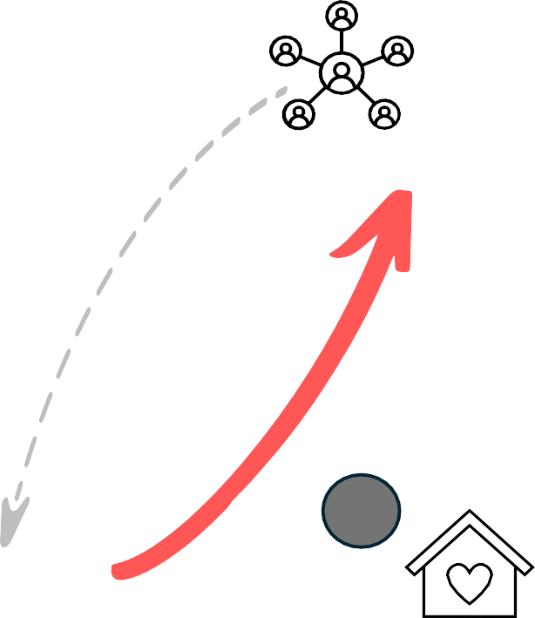

Our Approach Is Simple
Discharge Facilitators (multi-disciplinary clinicians) complete the clinical assessments.
Managed Service team of Patient Transition Liaisons execute on the Plan, coordinating with patients, families, agencies, vendors, fire inspectors, & community case managers to make necessary arrangements.
1
4
2
Clinical assessments are entered and/or imported to the Discharge Hub Portal.
5
Patients return home with the services and information they need.
3
A Plan, inclusive of tasks and templates, is auto-generated to share the right information with the right stakeholders at the right time.

Slide 10
The value of DischargeHUB is multifaceted
Clinical Time Savings
Reduced Length of Stay
Home First Philosophy
Data-Driven Problem-Solving
Process Unification
Enabling more time to work to full scope of practice, reducing assessment backlogs & increasing job satisfaction
Contributing to better patient outcomes & more effective use of system resources
Supporting patients to age in place by helping navigate the home & community care system
Identifying trends and barriers to service to develop targeted mitigation strategies
Standardizing workflows to enable process unification as one NL Health Services

Slide 11
Early Impact & Learnings
How would you rate your satisfaction with the DischargeHUB team?
Q: Does DischargeHUB help you save time spent coordinating home support services?
79%
of DischargeHUB users are
“very satisfied” (5/5)
1 (not at all satisfied) 2
3
4
5 (very satisfied)
A: Absolutely! The speed at which home care is arranged is far quicker than the previous method.
It also allows more time for me to work on my other clients’ needs and/or offer greater quality care to the client.
- Social Worker, NL Health
Services
7 in 10
DPLNs & Social Workers “strongly agree” (5/5)
that DischargeHUB helps save time spent coordinating home support.
Responses from interim survey, NL Health Services, May 2024

Slide 12

Expanding our impact & quantifying the value
Phase 1: HSC & SCMH Key Objectives
Phase 2: WMRH & STRH Key Objectives
DischargeHUB Solution completeness and functionality
Staff satisfaction with DischargeHUB
Solution
Improved efficiency and workflows for discharge to home process
Measurement Period: Jan – July 2024
Status: Complete & Passed; Remain Operational
Reduction in patient length of stay
Time savings for clinicians
Process unification across zones
Patient-focused communication channels
Measurement Period: Nov 2024 – Jan 2025 Status: Additional 2 Sites Operational on Nov 12

Slide 13

Built Together in NL for National Impact
Informed by and co-designed through deep engagement and collaboration with NLHS Clinical Efficiency and the Innovation Team.
Truly a shared success. Delivering a made-in-NL solution to a national problem.
Joint courage to not seek perfection. Focused on pace to pilot to demonstrate what’s possible.
A DIVISION OF SEAFAIR
Continuous engagement and learning, leading to a deeper understanding of the product roadmap.

Slide 14
Our Journey is Just Beginning
August 2024 More than 200 patient discharges to home coordinated through DischargeHUB
November 2024 Expansion to Western Memorial Hospital + Sir Thomas Roddick Hospital
Provincial Roll-Out 2025
Provincial process unification
Central coordination of repatriations
ALC avoidance
Discharge planning upon admission
January 2024 Launch at St. Clare’s Mercy Hospital + Health Sciences Centre

Slide 15
Discharge HUB
A DIVISION OF SEAFAIR

